Slide 1

Università Politecnica delle Marche
Department of Life and Enviromental Sciences
Course of Biological Sciences
UREA AS A MARKER OF AMINO ACID METABOLISM IN PRETERM INFANTS
Candidate: Tutor:
Martina D’Ercole Prof. Virgilio P. Carnielli
Academic Year 2018/2019

Slide 2
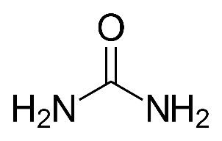
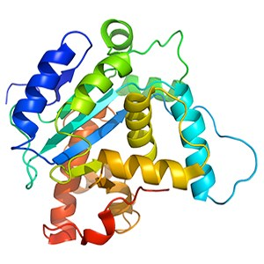
2
INTRODUCTION – Amino Acids (AA)
AA are essential compounds for fetal and neonatal growth.
Both current parenteral nutrition and enteral nutrition guidelines in newborns, suggest an AA administration from the first day of life.
Urea
Proteins
AA
Diet

Slide 3



3
INTRODUCTION – Physical Activity (PA)
In adults, combined physical activity and high AA intakes have been associated with a good fitness.
Few data are now available on infants about high AA intake and physical activity.

Slide 4

AIMs OF THE STUDY
4
Objective 1: to establish the impact of physical activity on growth in newborns who received high or standard AA intakes
Objective 2: to assess differences in terms of blood and urinary urea between infants who received high or standard AA intakes with or without physical activity.

Slide 5
5
MATERIAL AND METHODS – Patients And Time Point
INCLUSION CRITERIA | EXCLUSION CRITERIA
Gestational age at birth between 24 and 31 weeks | Inability to start physical activity within 10 days of life
Beginning of parenteral and / or enteral nutrition within 24 hours of life | Death within 36 weeks PMA
Absence of congenital malformations | Development of necrotizing enterocolitis (NEC)
Birth
32W
34W
36W
Gestational age
Birth Weight
Lenght at birth
Weight
Lenght
Blood
Urine

Slide 6
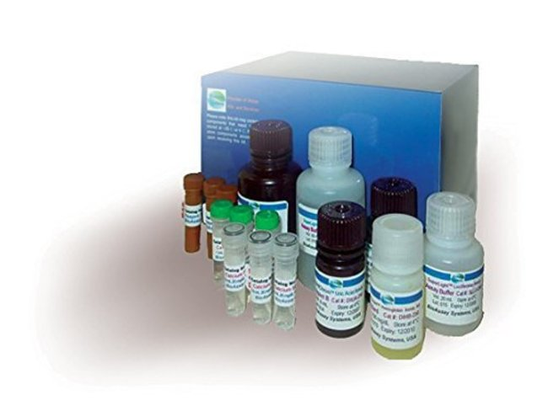
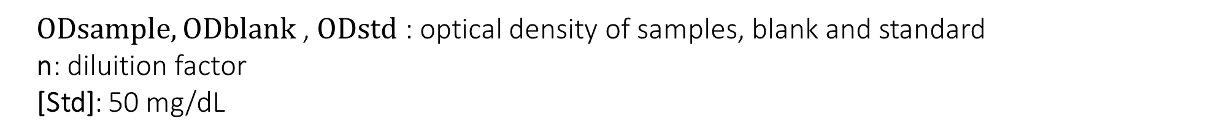
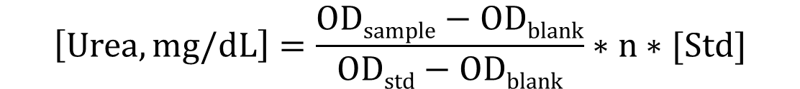
6
MATERIAL AND METHODS - Quantitative Colorimetric Urea Determination
Samples Type Plasma, serum or urine (5 µL)
Reagent Chromogenic reagent (200 µL)
Wave Lenght λ= 520 nm
Incubation 20 minutes at room temperature
Calculation
$$\left[Urea, mg/dL\right]=\frac{ODsample−ODblank}{ODstd−ODblank}∗n∗[Std]$$
$ODsample,ODblank$, $ODstd$ : optical density of samples, blank and standard
n: diluition factor
[Std]: 50 mg/dL

Slide 7
RESULTS – Diagram Flow
7
163 preterm infants (24⁺⁰-31⁺⁶ W PMA)
were admitted at the NICU from March2017-May2019
96 patiens were excluded
66 preterm infants (24+0-31+6 W PMA)
were available for the final evaluation
RANDOMIZATION: ENERGY INTAKE and PHYSICAL ACTIVITY
Group
Energy⁺ PA⁺
(n=16)
Group
Energy⁺ PA⁻
(n=16)
Group
Energy_{Std} PA⁺
(n=16)
Group
Energy_{Std} PA⁻
(n=18)

Slide 8
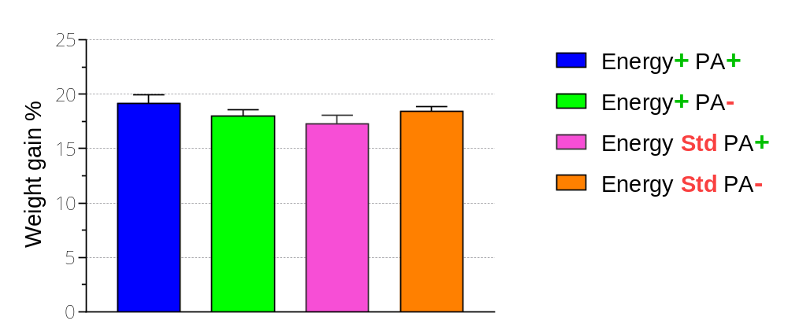
RESULTS – Weight Gain from Birthweight
recovery to 36 W
8
p=0.2
Data are shown as mean ± SE.
One Way ANOVA was used for statistical analysis.

Slide 9
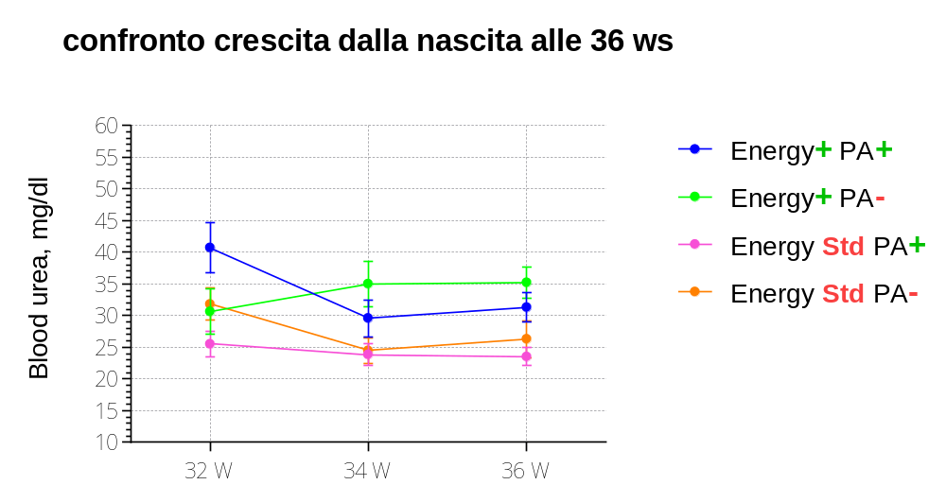
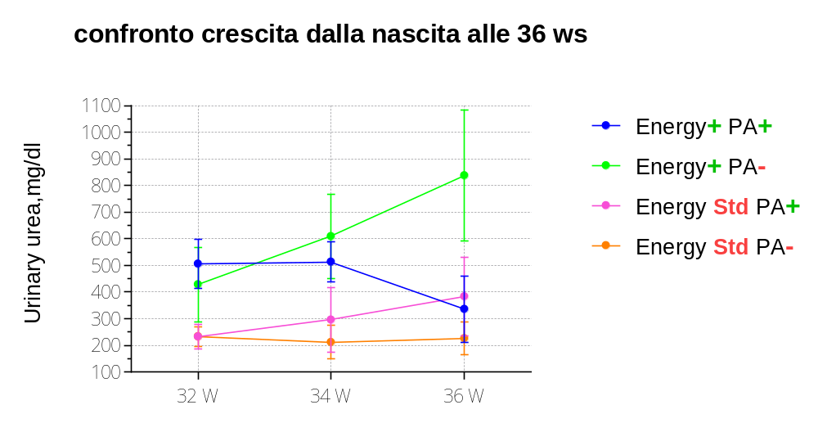
RESULTS – Blood and Urinary Urea
9
0.010
0.012
0.005
0.022
0.078
0.056
Data are shown as mean ± SE.
One Way ANOVA was used for statistical analysis.

Slide 10
CONCLUSION
10
The key results are:
Infants that received high AA intakes and physical activity had a higher weight gain than other groups
Blood urea was greater in infants who received high AA intakes without physical activity

